Slide 1
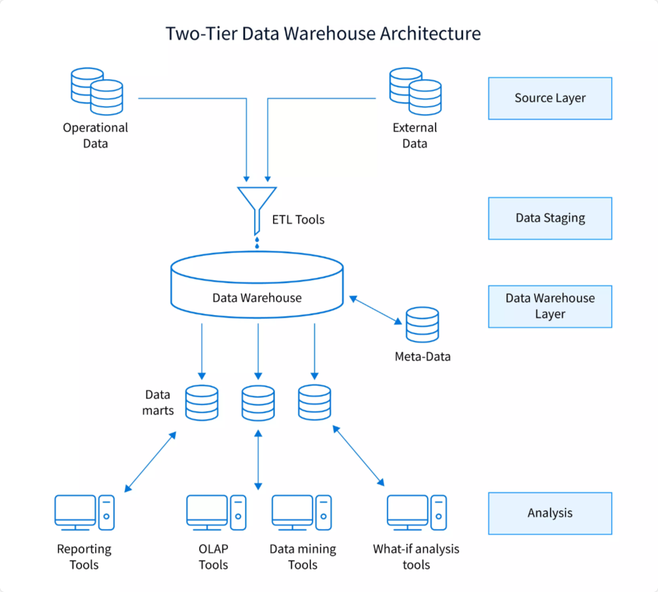
Data Warehouse Implementation on Daraz Dataset
This project focuses on building a centralized data warehouse to collect, store, and organize data from various sources. The goal is to provide the Daraz company with a robust platform for data analysis and informed decision- making.

Slide 2

Team Members
1
Areeba Saeed
CT -21005
2
Hayah Ahmed
CT-21010
3
Maryam Irfan
CT-21018
4
Mustafa Sheikh
CT-21049

Slide 3
Introduction to Data Warehousing
Project Overview
The main objective is to build a data
Warehouse for Daraz data that consolidates data from multiple sources, enabling comprehensive analysis and reporting to support the company's decision- making process.
Benefits
By centralizing data, the data warehouse
Scope
The project will focus on extracting,
transforming, and loading data from various csv files from Kaggle into a unified data warehouse structure.
will improve data accessibility, data
quality, and reporting capabilities, ultimately leading to more informed
business decisions for Daraz.

Slide 4



TECHNOLOGIES USED
The chosen database for storing transformed data in a structured and query-friendly format.
Used for executing ETL processes and data transformations.
Selected for visualizing data insights, supporting in-depth analysis.

Slide 5

Data Collection
Product.csv
Details product categories, titles, and other relevant attributes.
Sales.csv
Logs transactions, including items sold, sales regions, sale amounts, and quantities.
Reviews.csv
Contains customer reviews, ratings, and related product identifiers.

Slide 6
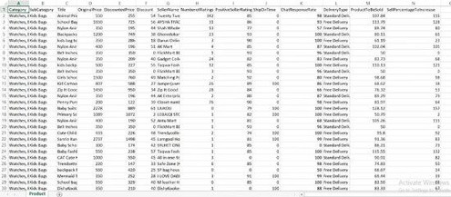
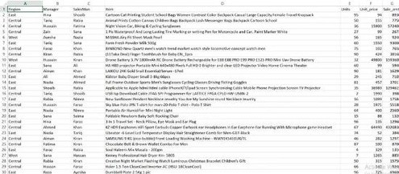
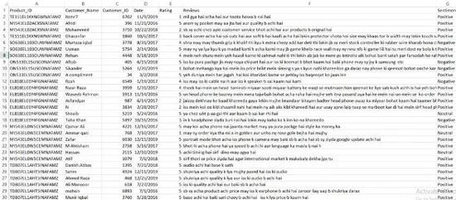
CSV FILES OVERVIEW

Slide 7
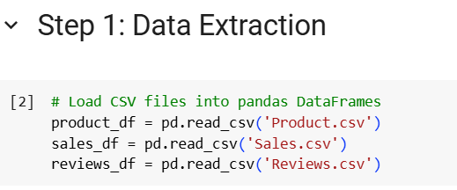
Extract
ETL Operations
Each file (Product.csv for product details, Sales.csv for transactions, and Reviews.csv for customer feedback) was read into data frames using Python’s pandas library for initial inspection and preparation for transformation.

Slide 8
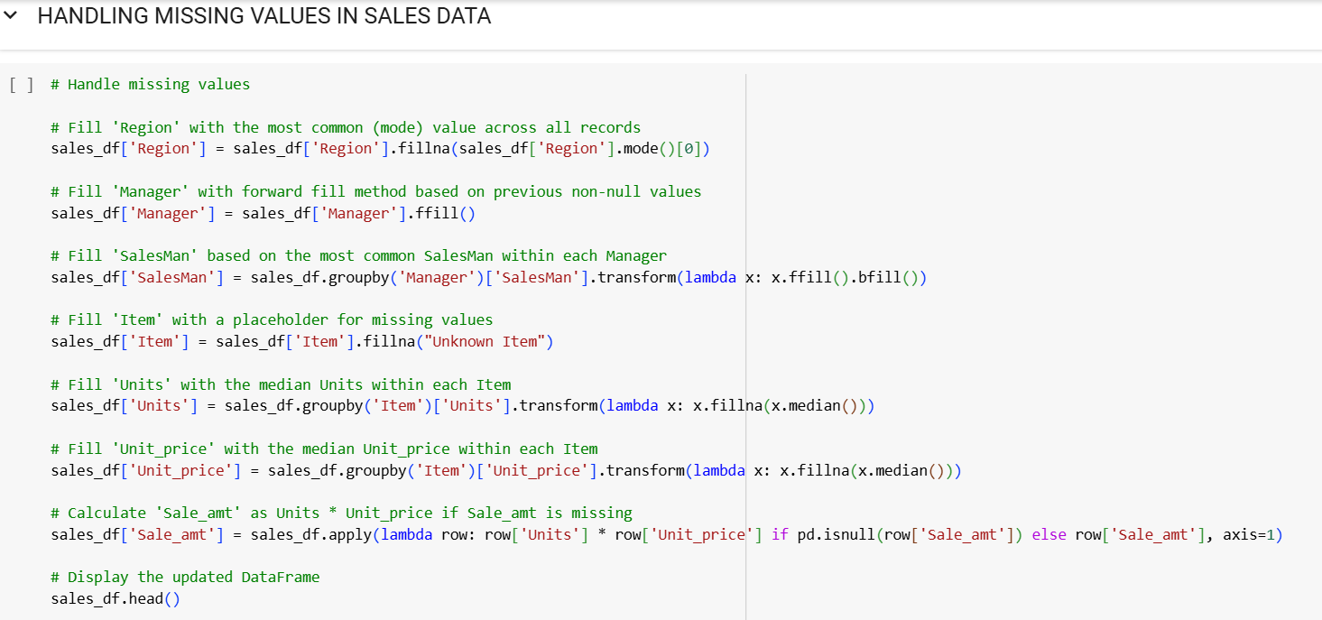
Transformation (HANDLING MISSING VALUES)
ETL Operations

Slide 9
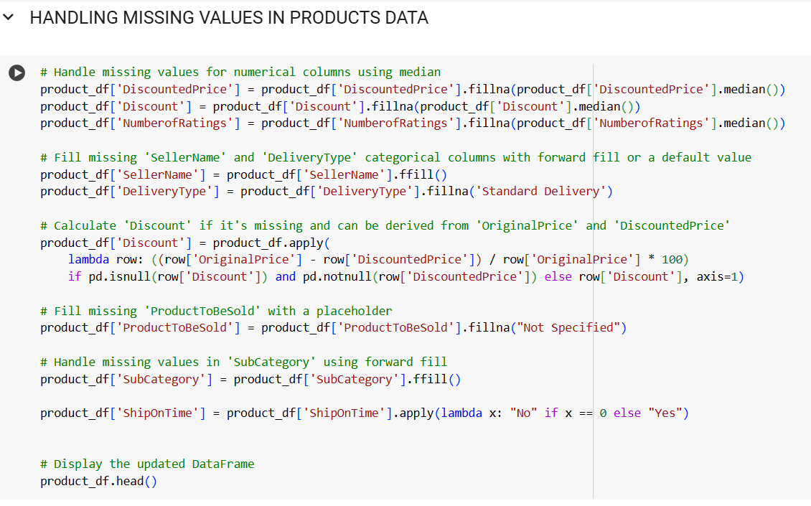
Transformation
ETL Operations
Transformation (HANDLING MISSING VALUES)

Slide 10
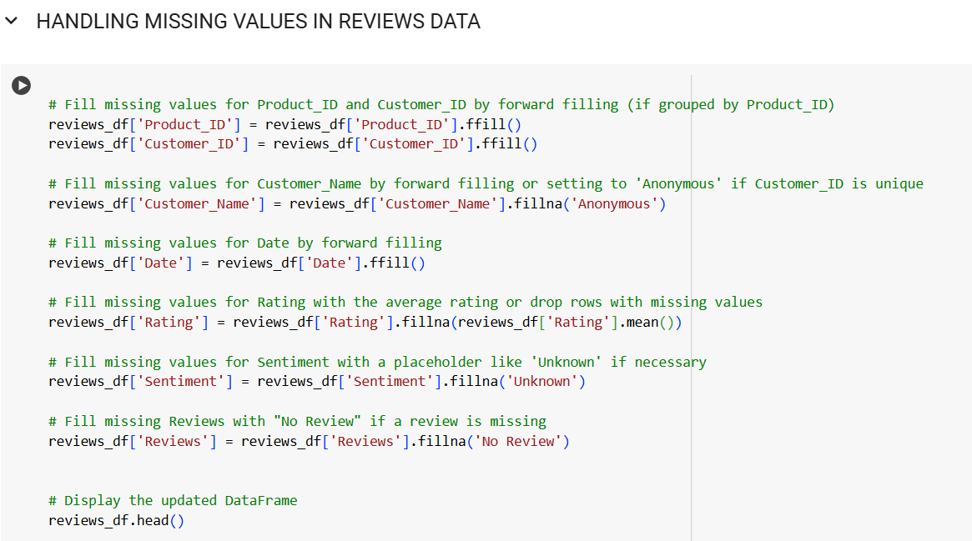
Transformation
ETL Operations
Transformation (HANDLING MISSING VALUES)

Slide 11
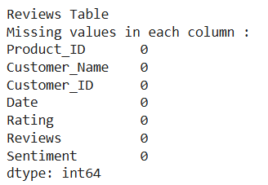
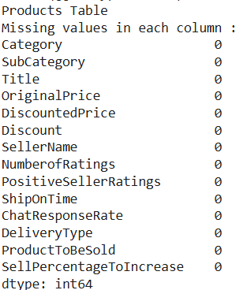
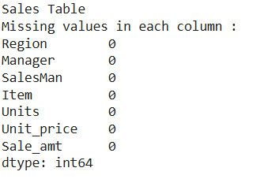
VERIFYING THERE ARE NO MISSING VLAUES
ETL Operations

Slide 12
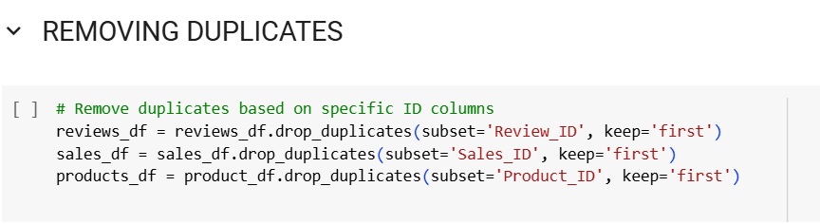
ETL Operations
Transformation
(REMOVING DUPLICATES)
We have removed duplicates on the basis of primary keys

Slide 13
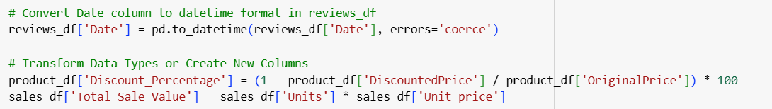
ETL Operations
Transformation
(Create new columns and data time format)

Slide 14
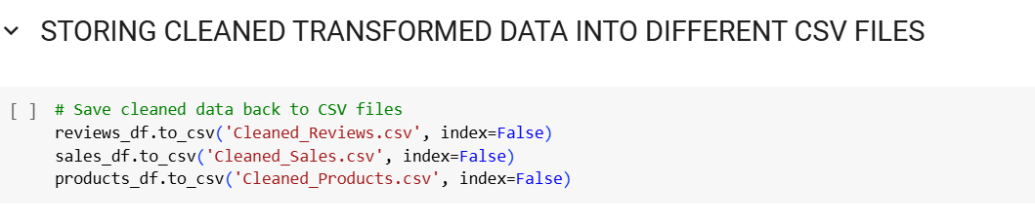
ETL Operations
Storing cleaned data In new files

Slide 15
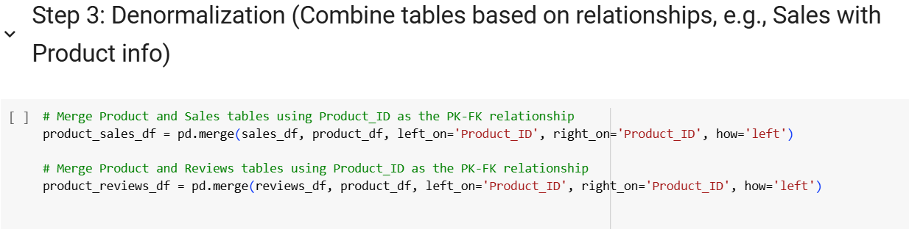
DENORMALIZATION
ETL Operations
We denormalized the data by merging sales with product information into a Product-
Sales table and reviews with product details into a Product-Reviews table, improving query performance and simplifying access for analysis.

Slide 16
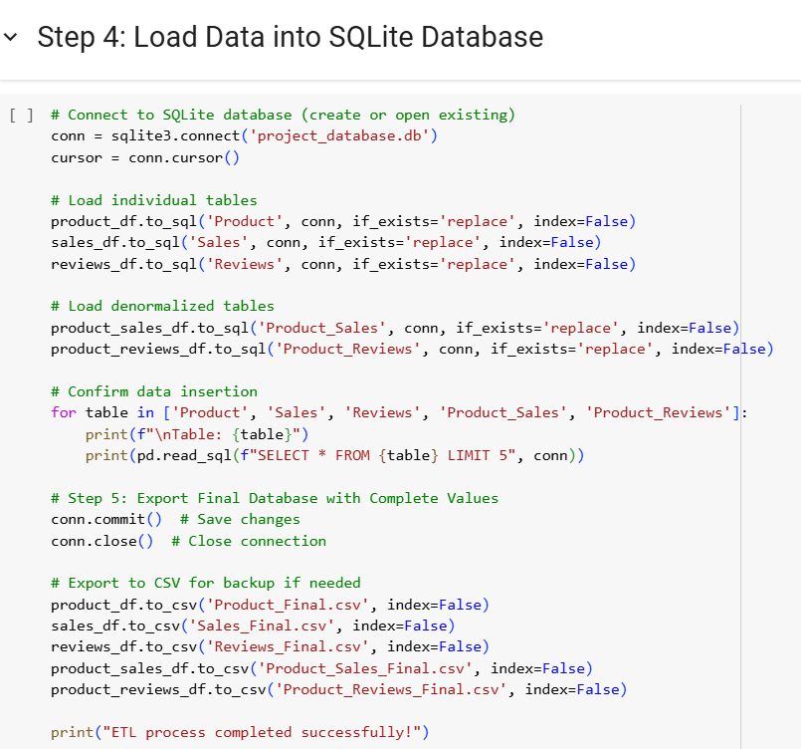
LOAD
ETL Operations
The denormalizaed data was stored in an SQLite database, project_database.db. This organized storage allows fast querying for analytics and reporting.

Slide 17
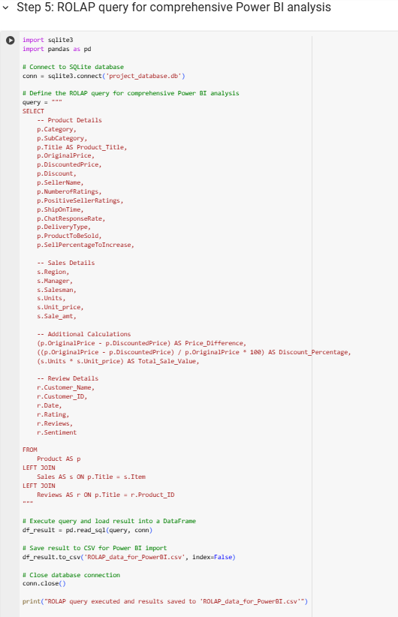
Data RoLAp Query

Slide 18
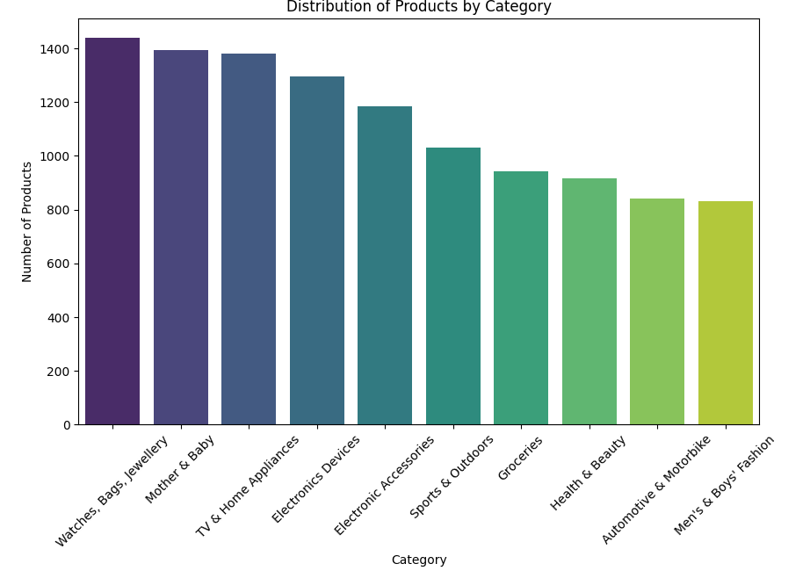
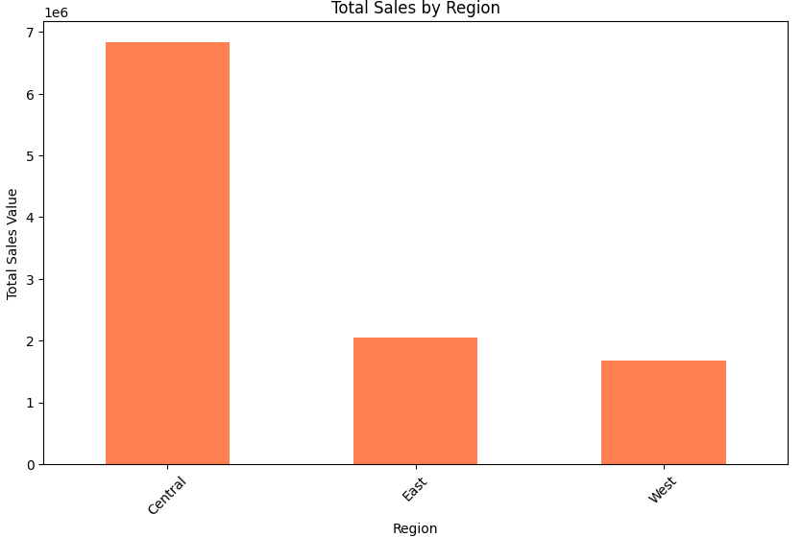
Graph Illustrations through Pythons’s library Matplotlib

Slide 19
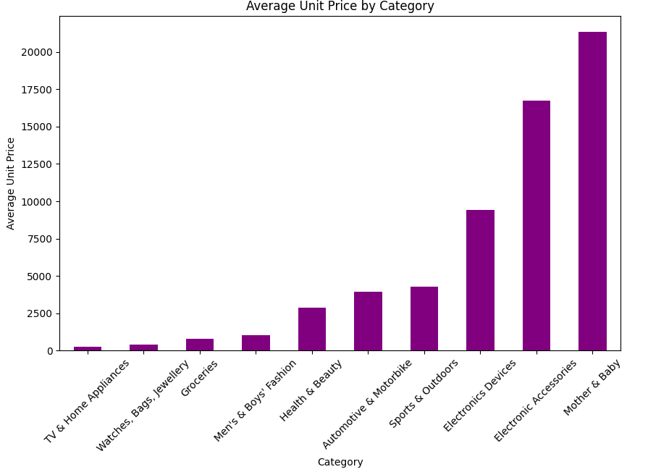
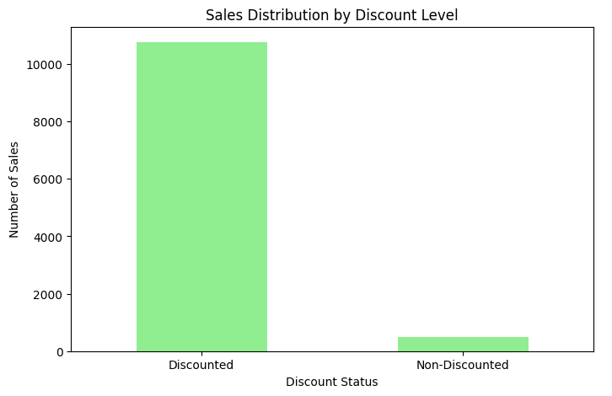
Graph Illustrations through Python’s library Matplotlib

Slide 20

Visualization
The Power BI dashboard is designed to visualize key performance indicators (KPIs) such as total sales, units sold, product categories, and regional performance
Sales Performance Overview
The Daraz Sales Data Analysis dashboard visualizes key performance indicators (KPIs) like total sales and regional performance, facilitating data-driven decision-making.
Trend Identification and Evaluation
It enables trend identification and evaluates salesperson performance while enhancing understanding of product demand across categories.

Slide 21
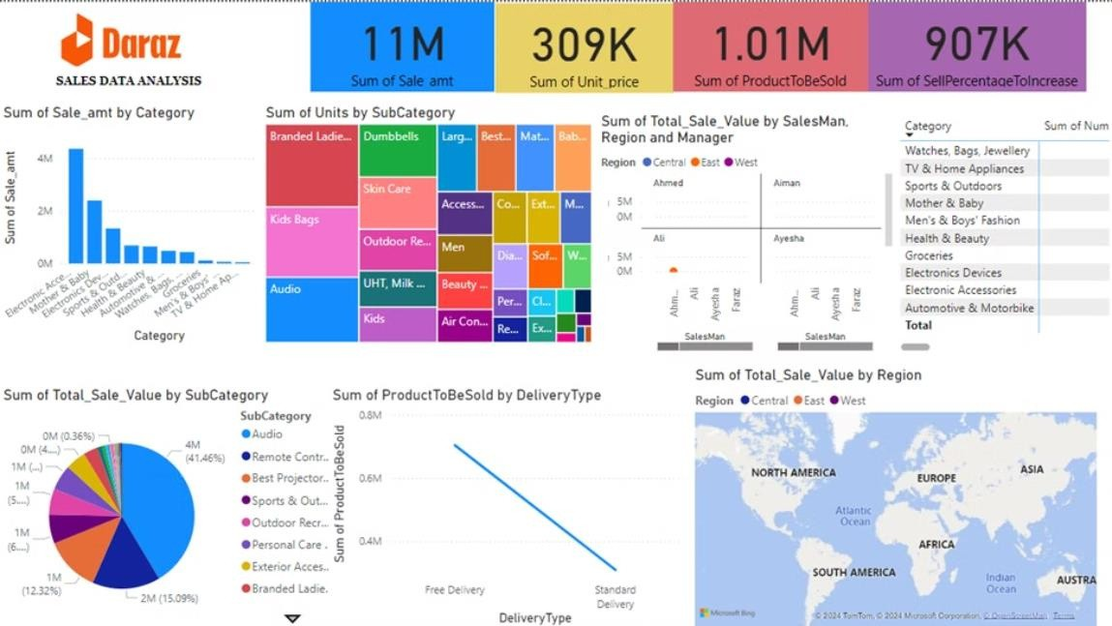
POWER BI DASHBOARD

Slide 22
Different visuals
Total Sales Metrics(Sales Amount: 11M, Unit Price: 309K, Products to be Sold: 1.01M, Sell Percentage Increase: 907K
Sum of Sale Amount by Category
Units Sold by SubCategory (Treemap)
Sales by Salesman, Region, and Manager
Category-wise Sales Breakdown
SubCategory Sales Share (Pie Chart)
Products Sold by Delivery Type (Line Chart)
Sales by Region (Map Visualization)

Slide 23
THANK YOU

